Slide 1
Enter your email address and click “Join A Campaign”

Slide 2
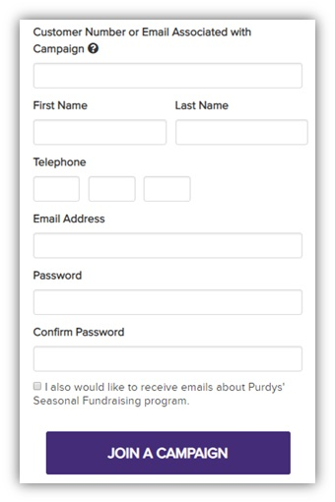
Complete the form and click “Join A Campaign”

Slide 3
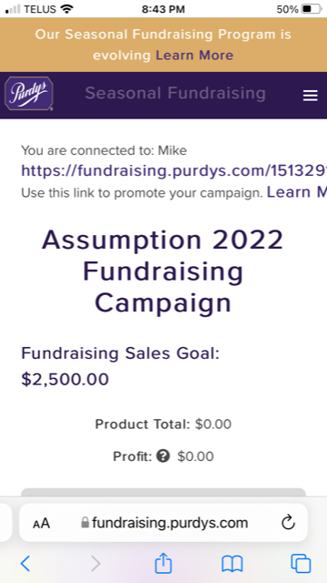
Click here to get to the shop and payment page

Slide 4
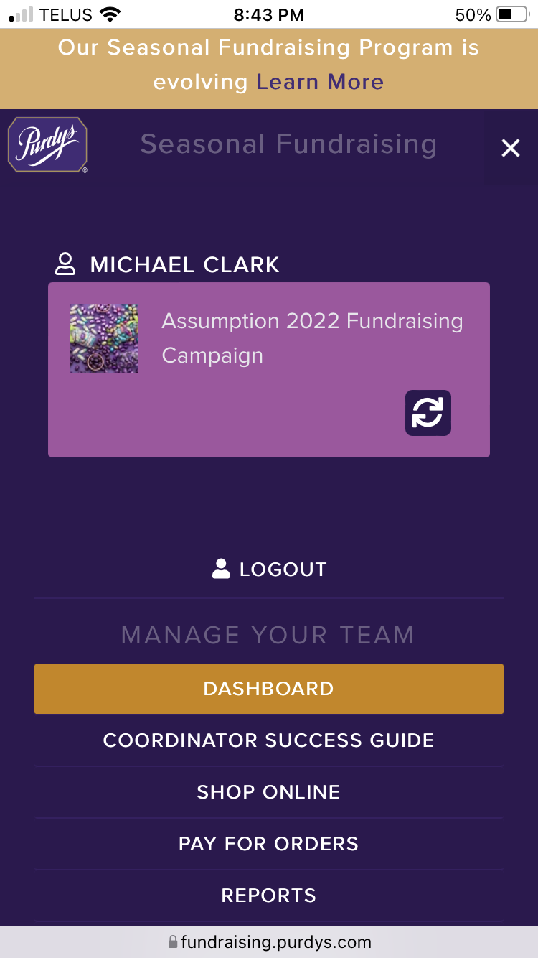
Click “Shop Online”

Slide 5
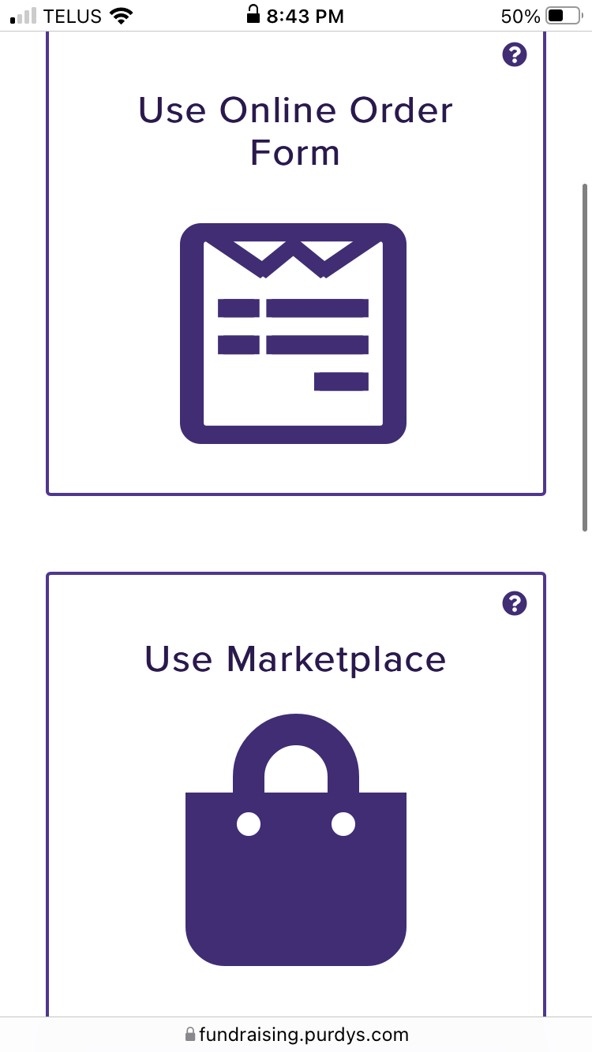
Click “Use Marketplace” and start Shopping

Slide 6
When you’re done shopping, click “Pay For Orders”

