Slide 1
Finding a Book in the Library Catalogue
Goto Loyola’s Homepage
http://loyola.hcdsb.org

Slide 2
Scroll Down and click on Search Our School Library

Slide 3
This takes you to the Catalogue Search Page

Slide 4
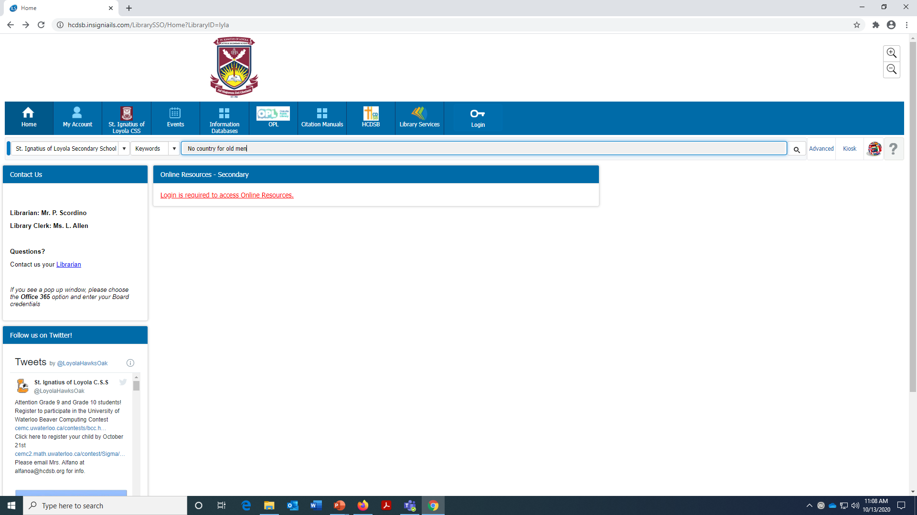
Put in your search terms. Click enter

Slide 5
Check for your title in the return list.

Slide 6
Click on title and check availability

Slide 7
Contact Mr Scordino to check out the item.
scordinop@hcdsb.org
I will get back to you with instructions on when and how to pick up and return your item. Have a great day.

