Slide 1

Applying to
Ontario’s Universities
karenskinner1978@gmail.com
www.ouac.on.ca/undergrad-guide

Slide 2
What do you need to Apply?
Ontario Education Number (OEN).
You can find your OEN on your report card. Your guidance counsellor will also have it on record.
Personal Email
Notes:
In the Education section, under “Tell Us More”, you will be asked if you will receive your Ontario Secondary School Diploma by the end of the current school year. When you respond “Yes”, you will be prompted to add your OEN.

Slide 3
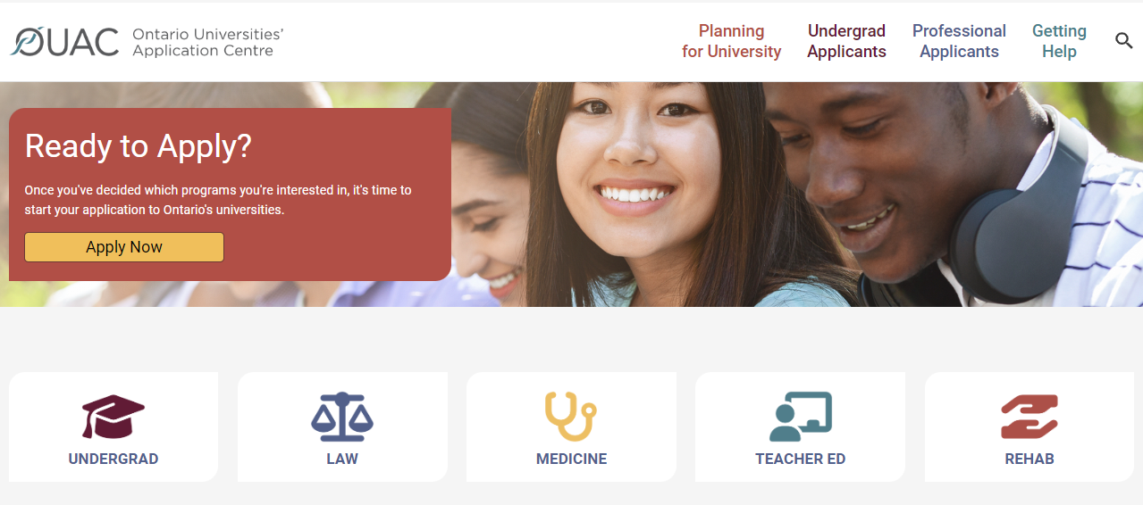
Ready to Apply!
Access the application at: www.ouac.on.ca.
Notes:
You will access the Undergraduate Application at: www.ouac.on.ca.
Read the Undergraduate Application Guide for in-depth instructions about how to complete the application: www.ouac.on.ca/undergrad-guide.

Slide 4

Ready to Apply!
Notes:
You will access the Undergraduate Application at: www.ouac.on.ca.
Read the Undergraduate Application Guide for in-depth instructions about how to complete the application: www.ouac.on.ca/undergrad-guide.

Slide 5
Ready to Apply!
Important notes:
First and last name, DOB
Your personal email
Verify your email
Unique username and password
Read the Terms and Conditions
Begin the “Undergraduate Application”
Notes:
You will access the Undergraduate Application at: www.ouac.on.ca.
Read the Undergraduate Application Guide for in-depth instructions about how to complete the application: www.ouac.on.ca/undergrad-guide.

Slide 6
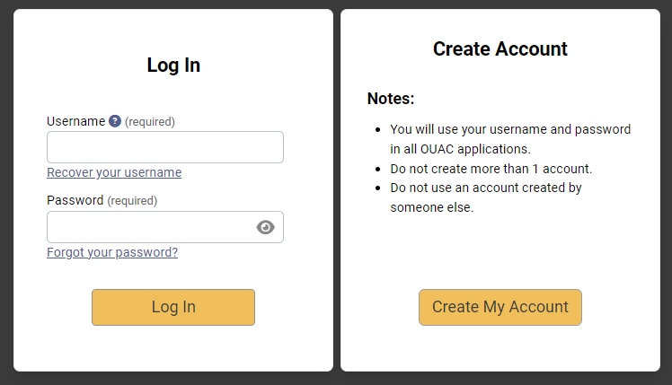
Creating an Account For the First Time
Notes:
You will provide basic personal information and create a username and password. You should create a username that is personal and easy for you to remember, as you will be using it to log in to your application from now on and to apply to all future OUAC applications.

Slide 7
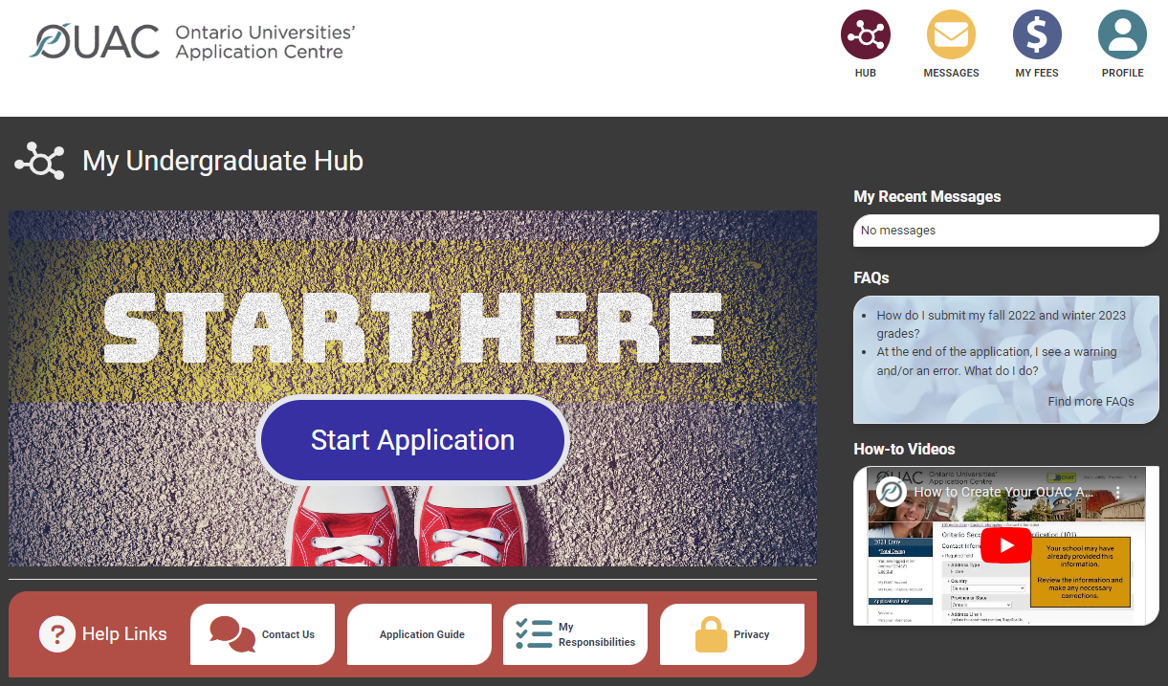
The Hub
The Hub is where you can access the different parts of your application and your Message Centre, and find a summary of the information you have added.
Notes:
Email messages from OUAC regarding application, offers
Total fees owed or paid
Change profile information including password

Slide 8
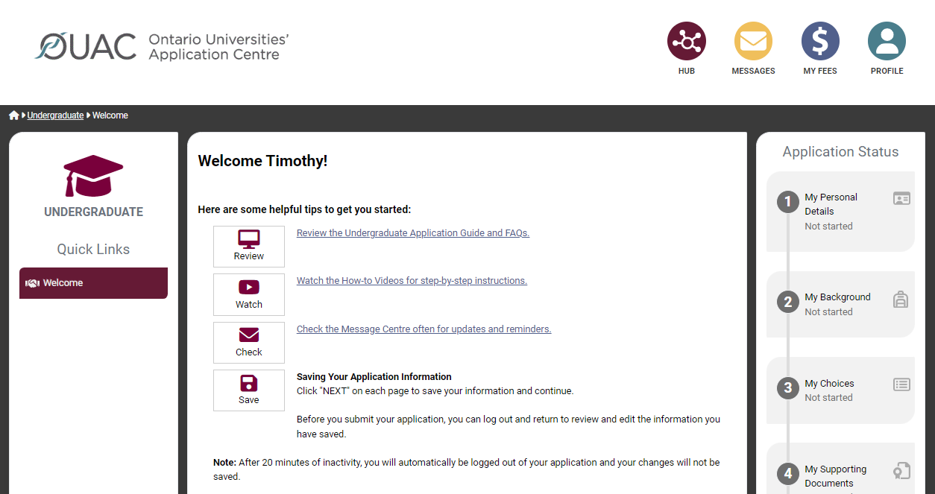
Welcome Page
Review the helpful tips on the Welcome page.

Slide 9
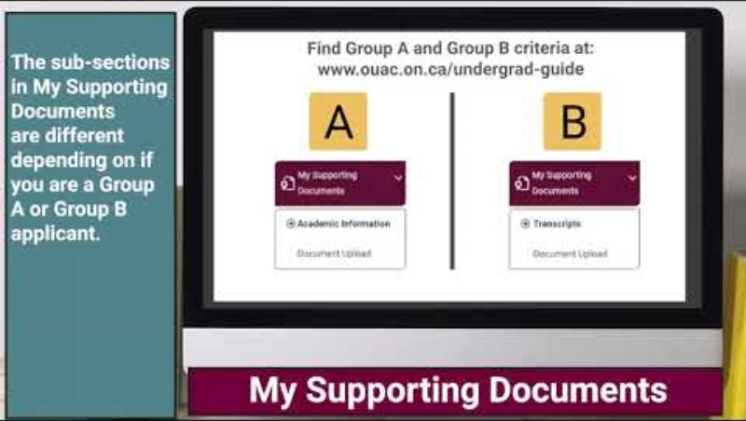
How to Complete your
Undergraduate Application

Slide 10
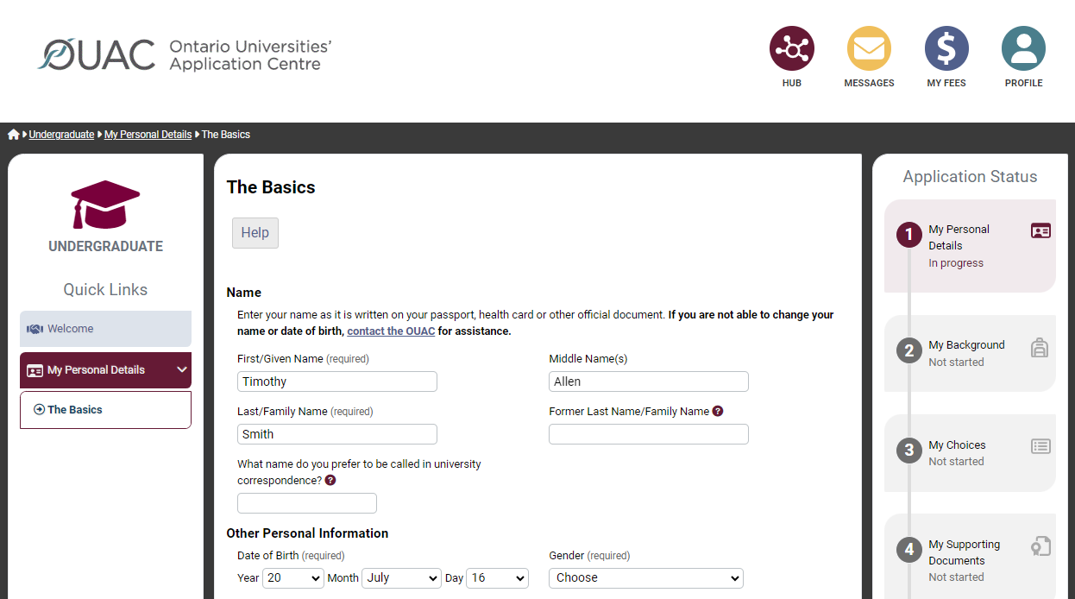
Navigating the Application
Notes:
The Quick Links menu appears on the left side of each page throughout the application (on a desktop computer). You are guided through the different sections of the application in order. The Application Status bar on the right side of each page shows you your progress through the application.

Slide 11
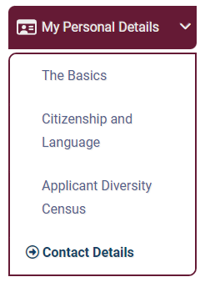
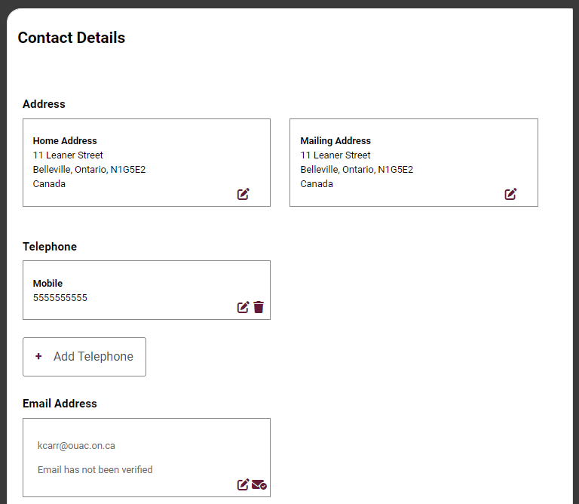
My Personal Details
c
c
c
You are not able to submit your application until you verify your email address.
c
Notes:
The My Personal Details section has 4 sub-sections: The Basics, Citizenship and Language, Applicant Diversity Census and Contact Details.
It is important that you provide all legal given names on The Basics page of My Personal Details. You should not use nicknames, abbreviations or initials.
You must enter your email address accurately, as the OUAC and the universities will correspond with you via email during the application process. We highly recommend you do not use school- or employer-issued email addresses.
When you create your OUAC account, you will receive an email asking you to click a link to verify your email address. You are not able to submit your application until you verify your email address. If you lose the email, you can re-send it to yourself through Contact Details.

Slide 12
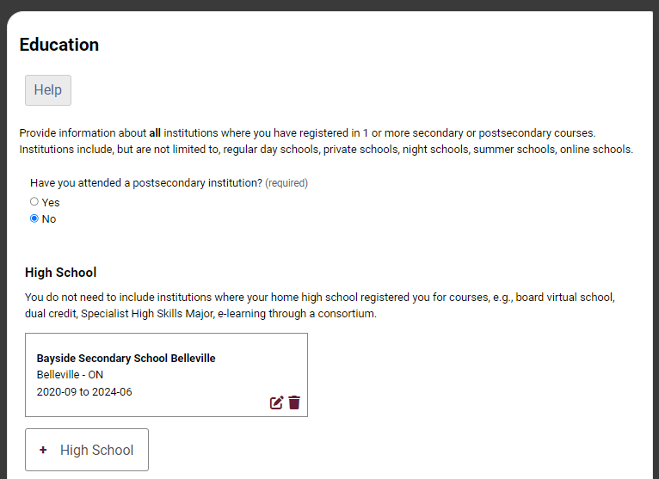
My Background – Education
Provide information about all institutions where you registered in 1 or more high school courses.
Day school
Night school
Summer school
Private school
Virtual school
Provide information about postsecondary courses you took as part of an enrichment or dual credit program.
Notes:
Institutions may include: Regular day schools, private schools, night schools, summer schools and virtual schools.
You do not need to include institutions where your home school registered you for courses (e.g., board virtual school, dual credit, Specialist High Skills Major, e-learning through a consortium).
You must add the month and year for when you expect to finish Grade 12 in the “To Date” field for your home school.

Slide 13
My Background – Education
“Will you be taking courses at this school anytime between September 1, 2025 and August 31, 2026?”
Enter the month, year you first starting attending
The highest grade completed or expected to complete
Notes:
Institutions may include: Regular day schools, private schools, night schools, summer schools and virtual schools.
You do not need to include institutions where your home school registered you for courses (e.g., board virtual school, dual credit, Specialist High Skills Major, e-learning through a consortium).
You must add the month and year for when you expect to finish Grade 12 in the “To Date” field for your home school.

Slide 14
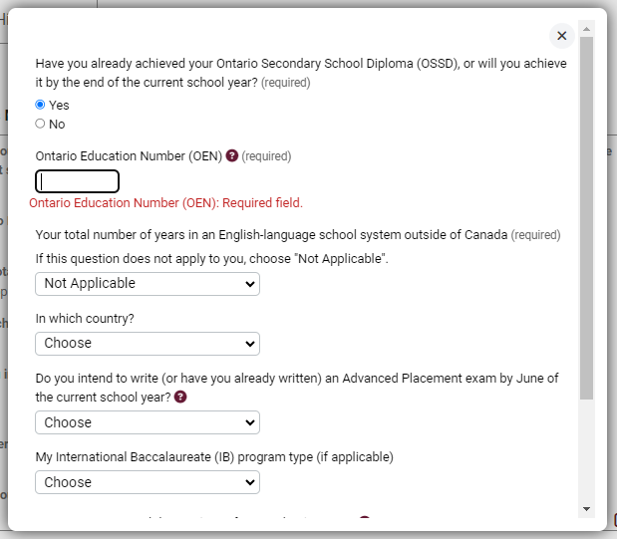
My Background – Tell Us More
Some fields are required. Select "Yes" to indicate you will achieve your OSSD, then add your OEN.
Notes:
After you add your institutions, you can tell us more details about your educational background.
You can find your OEN on your report card. Your high school guidance counsellor will also have it on record.

Slide 15
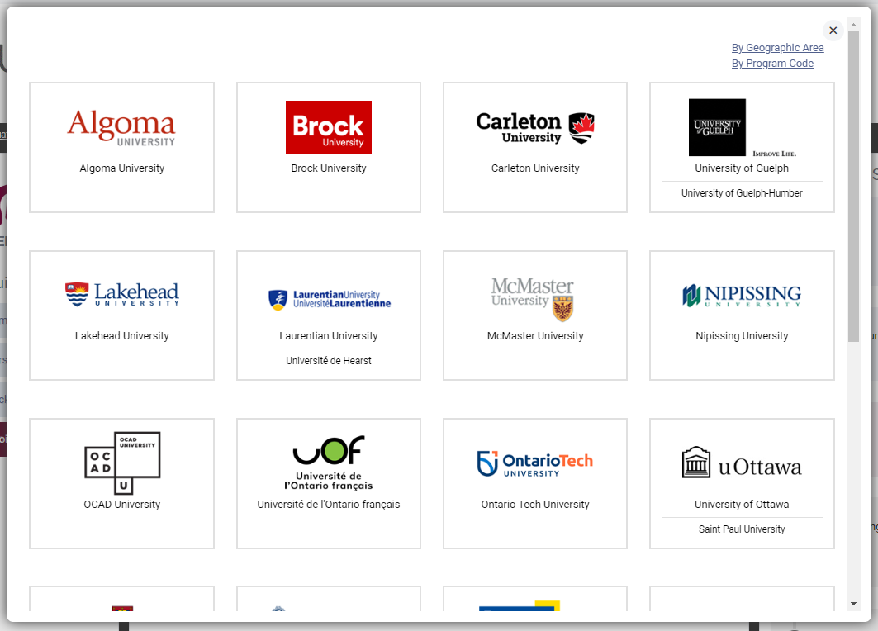
My Choices
You can search for programs by university, geographic area or program code.
Notes:
If you know the program codes of the programs you would like to apply to, you can add the program codes one at a time using the “By Program Code” search option.

Slide 16
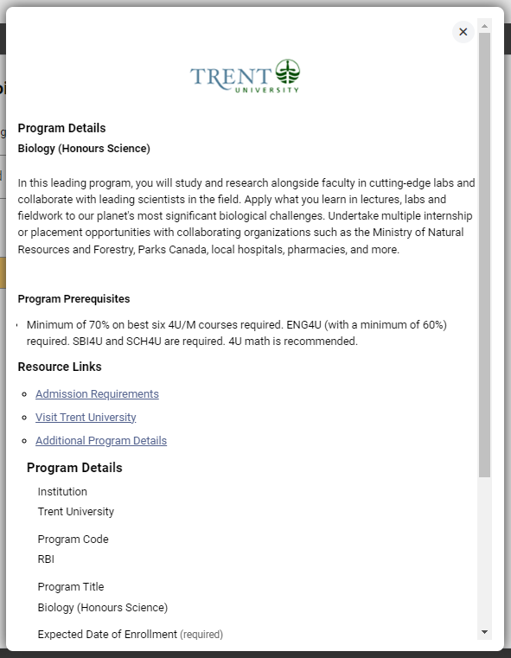
After You Have Selected a Program
Complete the program details for each program selected.
Read the program details
View the admission requirements for the program.
Subject of Major Interest
Expected date of enrollment
Co-Op
Notes:
Near the top of this page, you can view and confirm the admission requirements for the selected program.
You may apply to as many Ontario universities and programs as you wish; however, you are limited to a maximum of 3 program choices at any 1 university (including the university’s affiliates). Some universities may further limit the number of programs you may apply to.

Slide 17
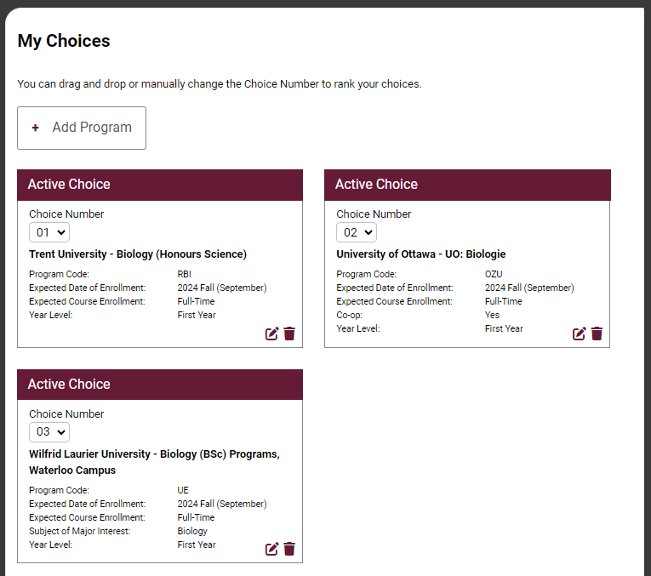
Order Your Choices
The choice order does not affect scholarship or admission consideration unless a university’s information specifically states that it does.
Notes:
Number or drag and drop your program choices in order of preference. Numbering does not affect scholarship or admission consideration unless a university specifically states this in its information. By default, program choices initially appear in the order that you selected them.

Slide 18
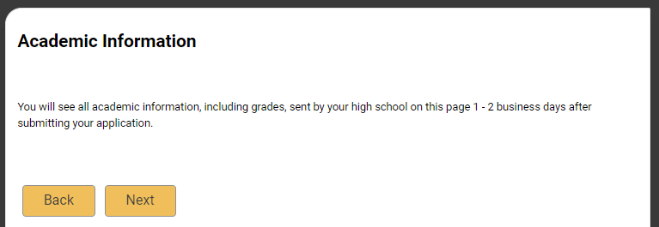
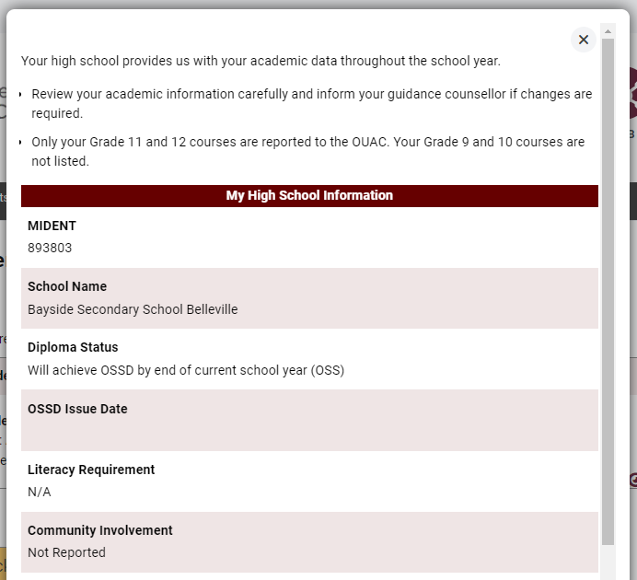
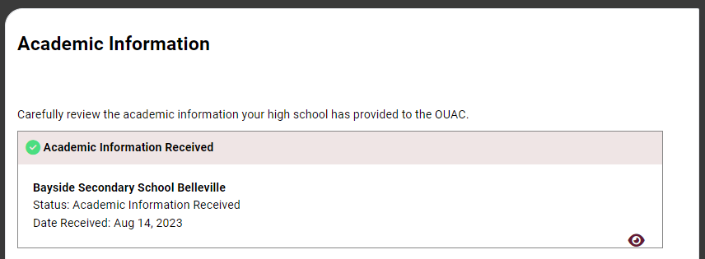
Academic Information
You are considered a Group A applicant = Grades are uploaded by the Board throughout the school year.
Monitor and report errors in your academic history to your guidance counsellor.
This screen is read-only.
Notes:
Your high school provides your academic information, including grades, to the OUAC.
Any grades on file for you will be auto-matched after you submit your application and will continue to be matched as your school updates your grades throughout the school year. This information is read-only.
Log in to your application 1-2 business days after you submit to check your matched academic information carefully. Inform your guidance counsellor if you find any errors.

Slide 19
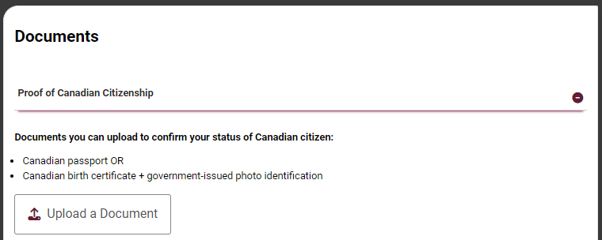
Document Upload
You can upload documents that support your application, as specified by your university choices.
Notes:
You can upload documents confirming proof of status in Canada and English-language test results, for example.

Slide 20
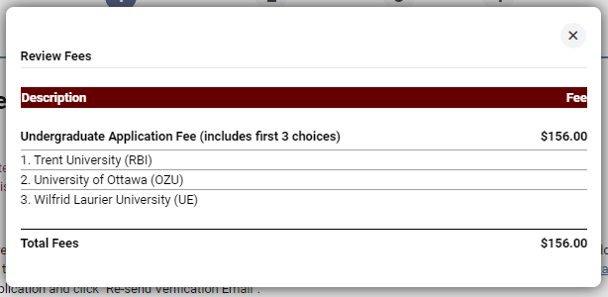
Fees
The cost is $156 for the first 3 university/program choices and $50 for each additional choice.
Some programs may have supplemental program fees which will be added to your total
Notes:
The cost is $156 for the first 3 university/program choices and $50 for each additional choice.
You can view your fees in real time by clicking “My Fees”.

Slide 21
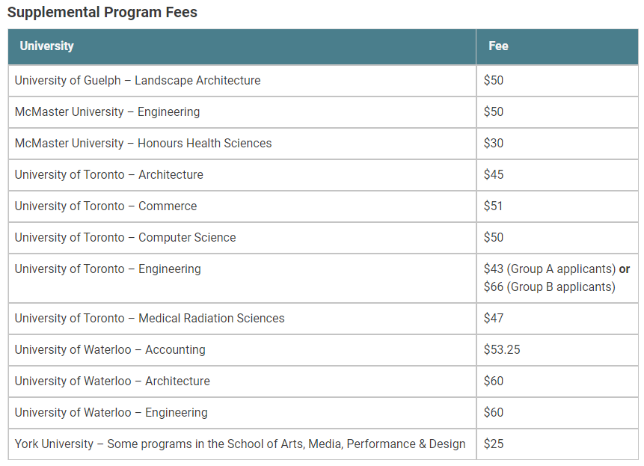
Fees
Some programs may have supplemental program fees which will be added to your total
Notes:
The cost is $156 for the first 3 university/program choices and $50 for each additional choice.
You can view your fees in real time by clicking “My Fees”.

Slide 22
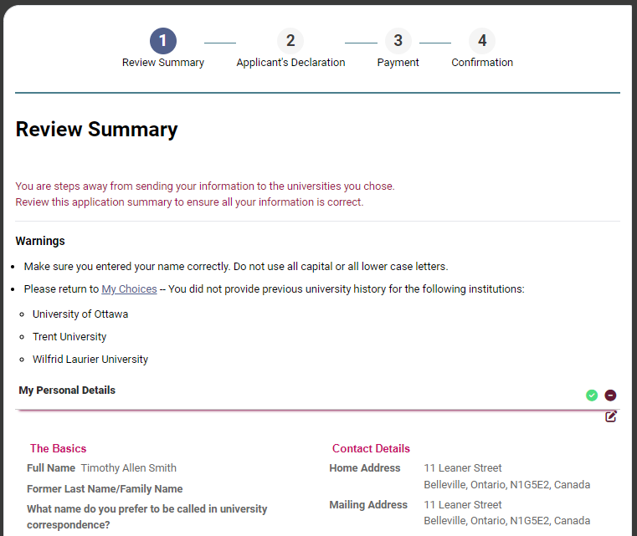
Review and Payment
Correct any errors to proceed to final steps
Expand each section
Unless you have previously applied to a school, you can ignore this warning
Notes:
Once you have added all information to your application, you can proceed to “Review and Payment” to review a summary of all the information you entered.
You must read the Applicant’s Declaration and click “I Verify and Agree”. After you click “I Verify and Agree”, you will not be able to edit your application.

Slide 23
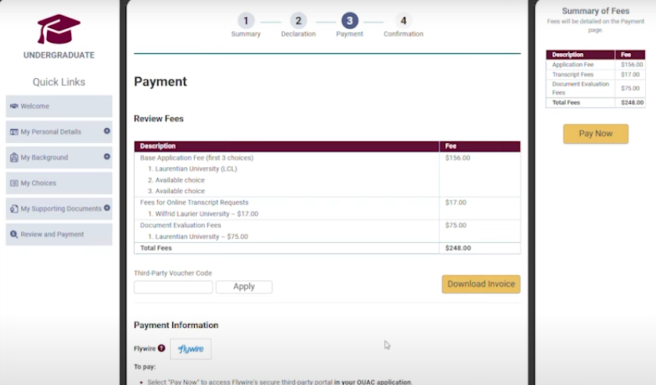
Paying for Your Application
Once you click “Pay”, you will receive your OUAC Reference Number -2025-XXXXXX
The OUAC cannot process your application without the application fee.
Notes:
To fully submit your application, you must select “CIBC International Student Pay” and click “Pay”.
The OUAC accepts payment through CIBC, a secure third party that allows you to make payments from within and outside Canada. You pay Canadian dollars in your local currency. When you click "Continue", you will be directed to CIBC to process your payment. When your transaction is complete, CIBC will send you a confirmation email. Click "Return to the OUAC" to return to your application.
Note: If your payment is declined or invalid, we will not process your application.
We will not distribute your application to your university choices until we receive and process your payment. You must make all payments at the same time you submit your application.

Slide 24
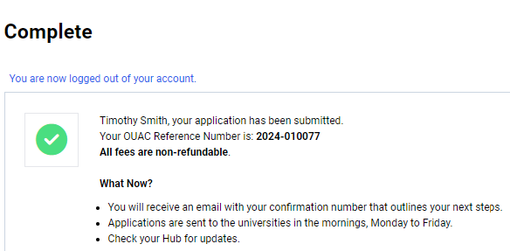
Submitting Your Application
On the Complete page, print the screen displaying your OUAC Reference Number (2025-XXXXXX) and instructions. You will also receive an email.
Record your OUAC Reference Number, as you will need to include it when communicating with the OUAC and the universities.
Notes:
Immediately after you submit your application, your OUAC Reference Number will be displayed. You should record your OUAC Reference Number, as you will need to provide it whenever you communicate with the OUAC or the universities.
You can view and/or make changes to your submitted application by logging in to your application at: www.ouac.on.ca/guide/undergrad-guide. You can view and/or make changes approximately 1 business day after you submit your application and your application fee payment is received and processed.

Slide 25
Your “To Do” list
      Book your Grade 12 Exit meeting with your Counsellor
      Recommend you complete your application before Christmas Break
      After applying, check your personal email often for confirmation of receipt of from the universities you applied to
        Universities to share their portal information with you. Here you will find:
          Additional required details like mandatory or optional supplementary applications, portfolios, auditions….
          Residence information
          Scholarships
          Status of your application
Notes:
These dates are established by guidance counsellors, the Ontario universities and the OUAC. Individual high schools may have additional internal deadlines.
You should not wait until the last minute to submit your application – internet connections may be interrupted as the deadline approaches. January 15, 2024, is the application deadline. We will accept applications after this date, but certain limited enrollment programs may no longer be available.

Slide 26
Mark Your Calendar!
      Late September 2025: The Undergraduate application opens.
      January 15, 2026: Deadline to submit your completed application to the OUAC.
      May 28, 2026: Last day you can expect a response from an Ontario university if you applied by the January 15 deadline.
      June 1, 2026: The earliest day you may be required to respond to an offer and give a financial commitment (e.g., registration or residence deposit).

Slide 27
QUESTIONS?

