Slide 1


St. Kateri Tekakwitha Catholic Secondary School
Gr 9 & 10 Presentation 2025:
Your Success Starts Here!
Notes:
Suzie
Good afternoon and welcome! The Student Services Team, myself, Mrs. Pietrobon-Flynn, Mr. Resendes, and Ms. Sneyd are looking forward to working with you this year and throughout your high school education. We’re going to take about 15 minutes to give you an overview of what we do and how we can support you.

Slide 2
Agenda
Student Services Department
Booking an Appointment
Timetables
Community Service (Volunteering)
Supports and Resources
School Involvement

Slide 3
Student Services Department
Mrs. Howitt – Guidance Secretary
Mrs. Pietrobon-Flynn – Guidance Counsellor, surnames A - E
Mr. Resendes – Guidance Counsellor, surnames F - N
Ms. Sneyd – Guidance Counsellor, surnames O - Z
Mrs. Bell - Alternative Education & Student Success Teacher
Mrs. Klimitz - Alternative Education & Student Success Teacher

Slide 4
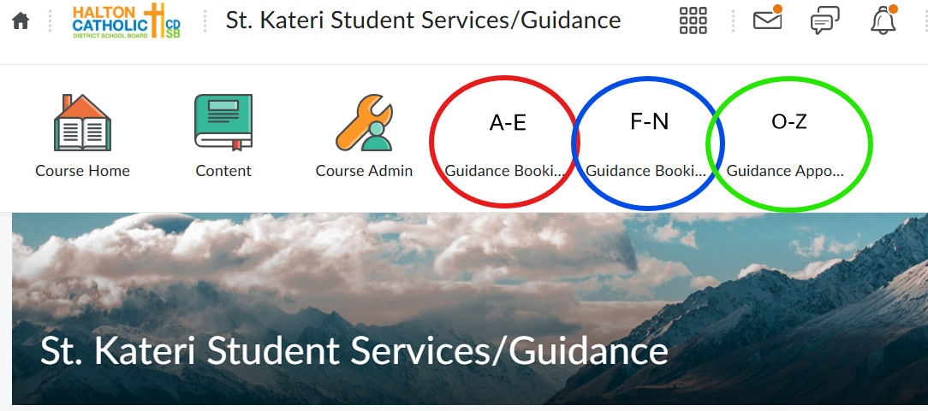
Booking an Appointment with your Guidance Counsellor
Appointments are booked through the Student Services D2L page
Must be logged-in to your HCDSB student account and not on a VPN
You must book with your assigned guidance counsellor
Notes:
If you book with a different counsellor, your appointment will be canceled and will need to be rescheduled
If you don’t see any appointments available, please check back the following day as new appointments open up each day.
Gr 12 Transition Planning appointments are for grade 12 students only. If you book one of these appointments and are not grade 12, your appointment will be cancelled and will need to be rescheduled as a general guidance appointment.
Mrs. Pietrobon-Flynn uses a Google form for appointment requests. No actual date or time is scheduled; I’ll call you down at my earliest opportunity. Might be same day or in a few days.

Slide 5

You do NOT need to book an appointment for any of the following reasons. Simply provide your paperwork to Mrs. Howitt (Guidance Secretary in Student Services) and your guidance counsellor will follow up:
Pre-approval form for volunteering
Proof of completing community service hours

Slide 6


Student Timetables
Incomplete timetables still being resolved
Cannot make changes for electives – choose carefully in February!
Course changes (ie. for pathway changes) require a meeting with a guidance counsellor – can not be done over email
MyBlueprint is a course request, not a guarantee!

Slide 7

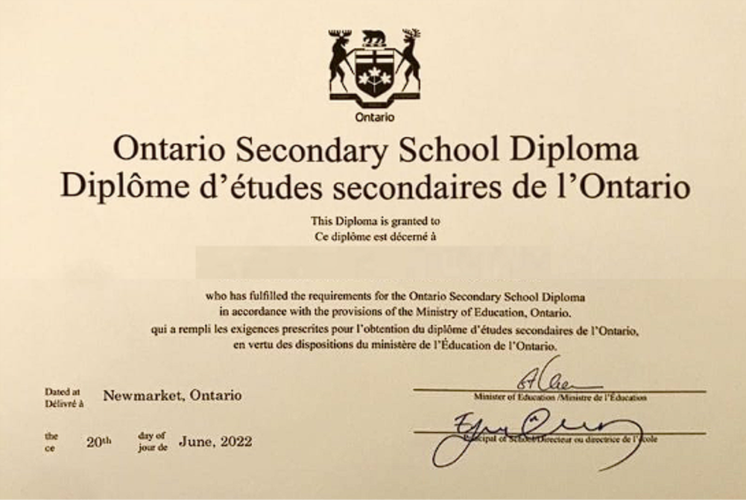
Community Service Hours
Requirement for graduation with Ontario Secondary School Diploma
Regulations are set by the Ontario Ministry of Education
40 community service hours with a non-profit organization (Town of Milton, library, elementary school, faith based organization, etc.)
Notes:
Recommend 10 hours per year

Slide 8
WHY Community Service Hours?
“Volunteering as part of your high school experience helps you:
Develop transferable skills
Explore different sectors and potential careers
Learn about your role as a citizen
Be aware of how you can support and strengthen your community”
https://www.ontario.ca/page/get-your-high-school-volunteer-hours
Community Service activities can also help you:
Network
Build experience to include in your resume
Support you with post-secondary applications

Slide 9


WHY Community Service Hours?
Notes:
Connecting to our Board’s Theological Theme

Slide 10
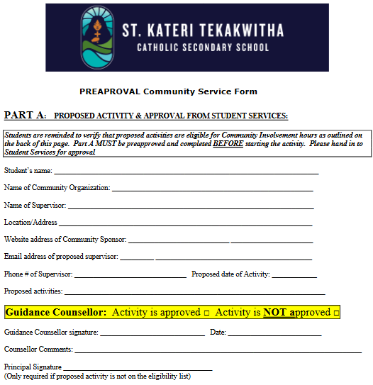
Pre-Approval Form
Must receive pre-approval before starting an activity
Volunteering vs Community Service - not all activities or organizations qualify for Ministry of Education recognition
Pre-approval forms list eligible and ineligible activities
Notes:
There is a difference between community service hour requirements and volunteering, as not all activities or organizations that one might volunteer with qualify for Ministry of Education recognition of community service hours.
The pre-approval process ensures that organization don't take advantage of students, but also ensures that activities meet a minimum safety requirement.

Slide 11
Proof of Completing Community Service Hours
Required to submit a letter from the supervisor/organization outlining the community service activity. The letter must be written on the organization's official LETTERHEAD, and include:
Organization's name and contact information
Supervisor's name and contact information
Supervisor's signature
# of community service hours completed by the student
List of duties / responsibilities completed by the student
Date of the community service activity
Notes:
These letters can also be used for resumes, applying to scholarships/awards and as references. It is in the best interest of the student to obtain these letters.

Slide 12
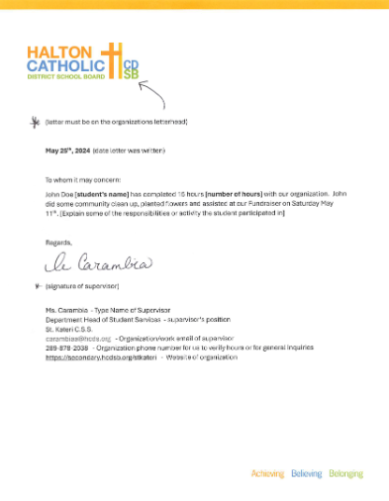
Sample Community Service Letter

Slide 13
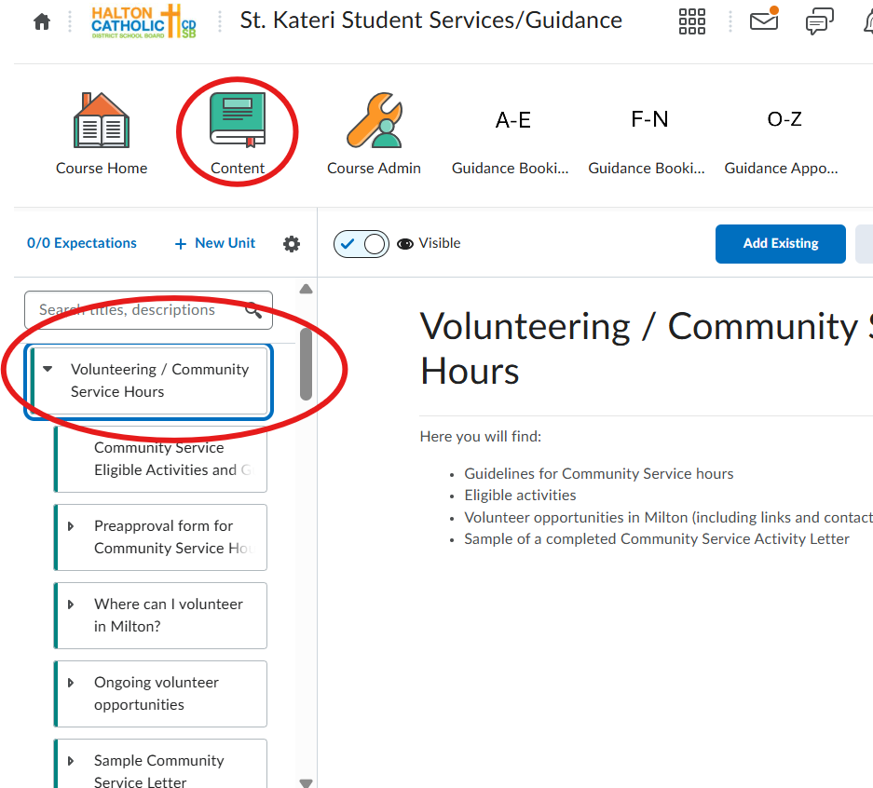
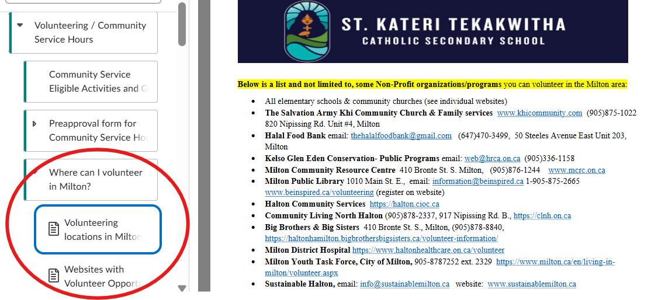
Where can I get more information about Community Service Hours?

Slide 14
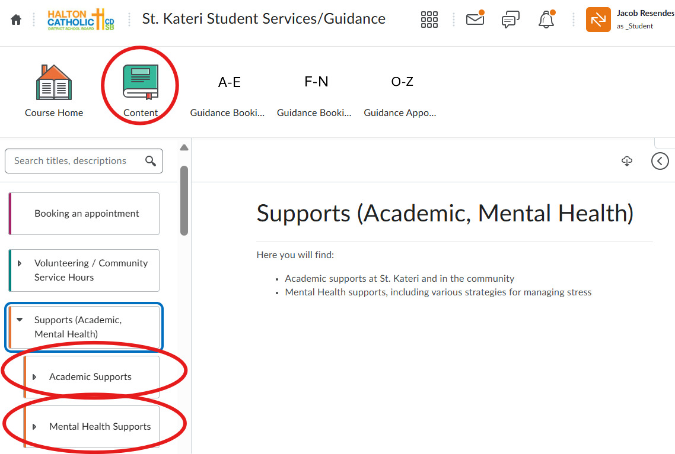
Supports and Resources
Notes:
We are all UNIQUE - with unique needs - please know that at St. Kateri - we have MANY, MANY resources to support you academically, socially, emotionally…key is that we EDUCATE you on your resources and EMPOWER you to use them

Slide 15
Academic Supports
Staff
Your classroom teachers!
SERTs (Mr. Thomson, Ms. Kostopoulos, Ms. Nieuwendyk, Mr. Jovanovic)
Student Success Teachers (Mrs. Bell & Mrs. Klimitz)
Graduation Coach for Black Students (Ms. Currie)
Librarian (Mr. Scordino)
Guidance Counsellors
Programs
Math Help
Numeracy Program
Science Help
OSSLT Prep
French Learning Lounge
Peer Tutoring

Slide 16
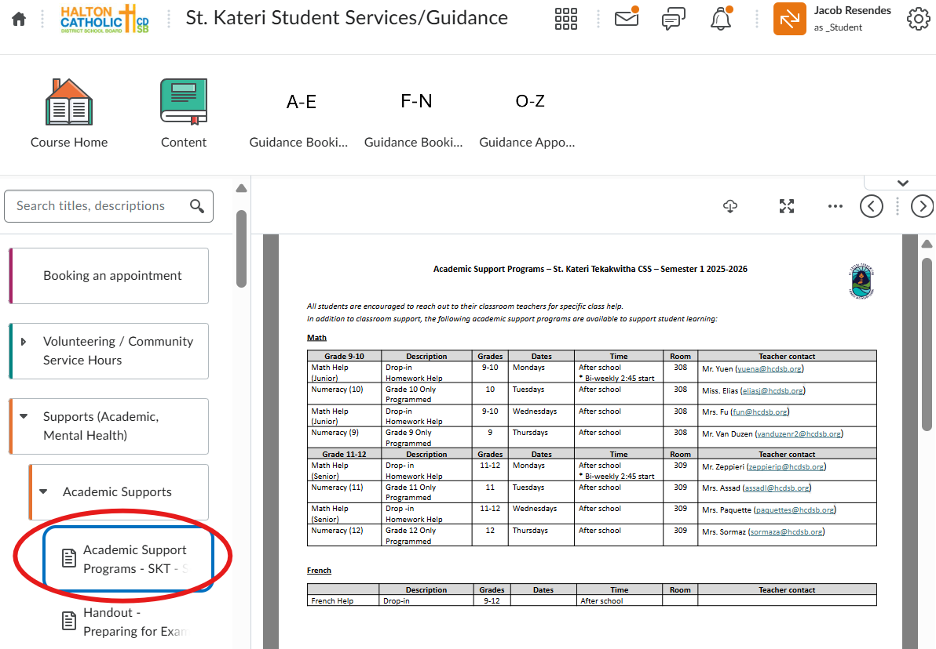
Notes:
Academic supports are updated regularly

Slide 17
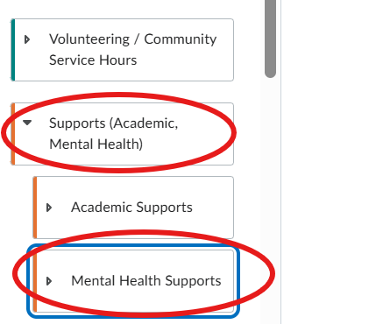
Non-Academic Supports
Guidance Counsellors
Chaplain (Ms. Taylor)
Graduation Coach for Black Students (Ms. Patricia Currie)
Child & Youth Counsellor (Ms. Sahar)
Social Worker (Ms. Kovacic)
Vice-Principals (Ms. Munro, Mr. Montoya)
Notes:
If you feel that you would benefit from additional supports in our building - please see your guidance counselor or your VP

Slide 18

Graduation Coach for Black Students
Patricia Currie - temporary Graduation Coach
Ministry of Education initiative
Designed to support success & well-being of Black students through culturally responsive, student-centred guidance
Voluntary and available to Black students in Gr 9-12, as well as their families
No referral is required to access support from the Graduation Coach
Notes:
Here at St. Kateri - we are blessed to have a Black Graduation Coach available to our students…

Slide 19
Graduation Coach Room
Space serves as welcoming, barrier-free environment where Black students can gather in community, receive academic and social support, and focus on personal growth and achievement
Library
Open to students on Thursdays during regular school hours

Slide 20
Graduation Coach Room
Students may use the Graduation Coach Room for:
A quiet, alternative space to complete assignments
Social-emotional check-ins
During lunch or spare periods
Access Procedure:
Student must request permission from classroom teacher before coming to the room
Teacher emails Patricia to confirm space availability (once phone is installed, teachers can call)
Once student arrives, Graduation Coach will confirm attendance via email to the teacher (phone call once installed)
Attendance: student is marked present in class if they are working in the Graduation Coach room

Slide 21
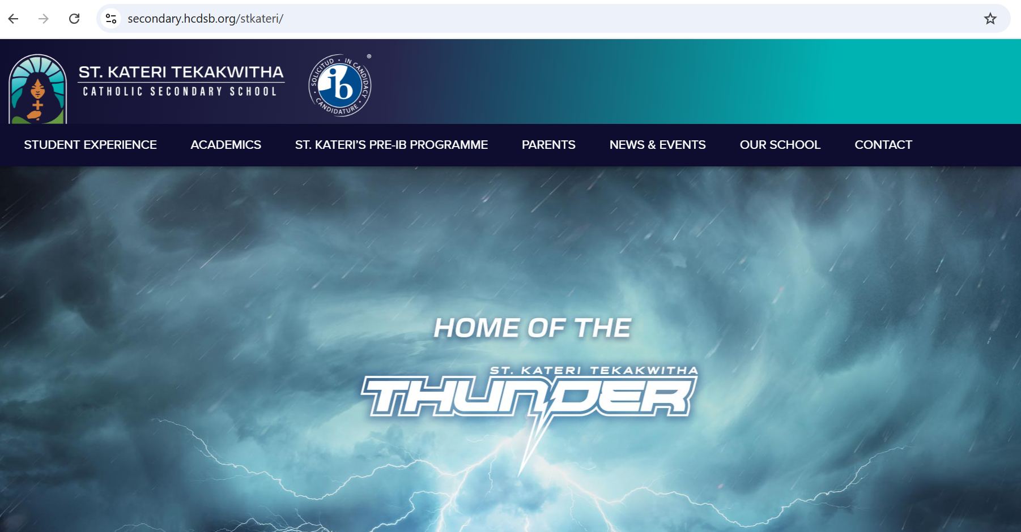
School Website
Check the school website daily for:
Daily Announcements
Important updates
Important information (programs, etc.)

Slide 22
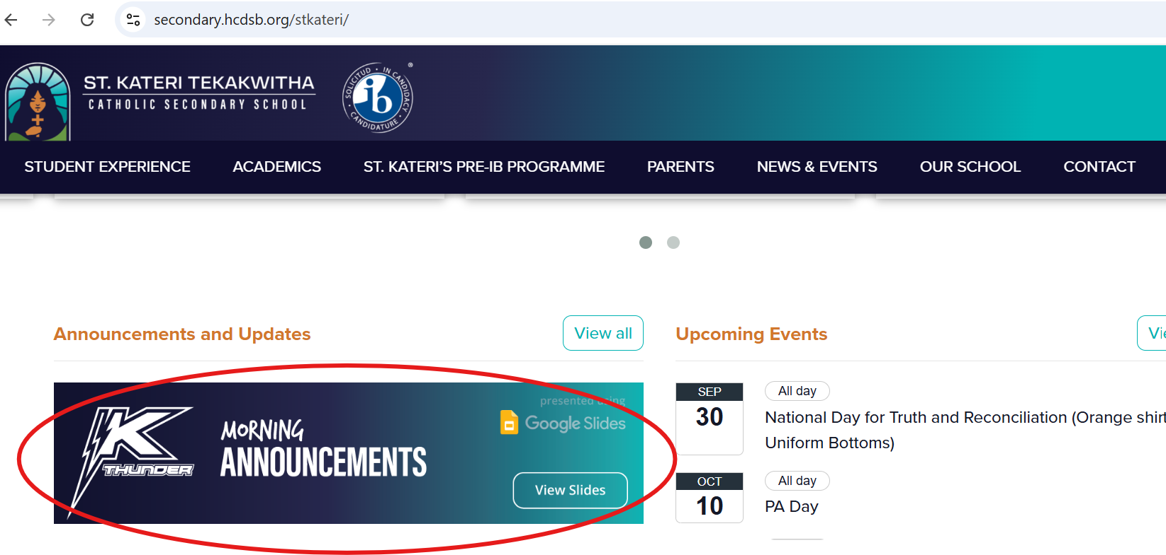

Slide 23
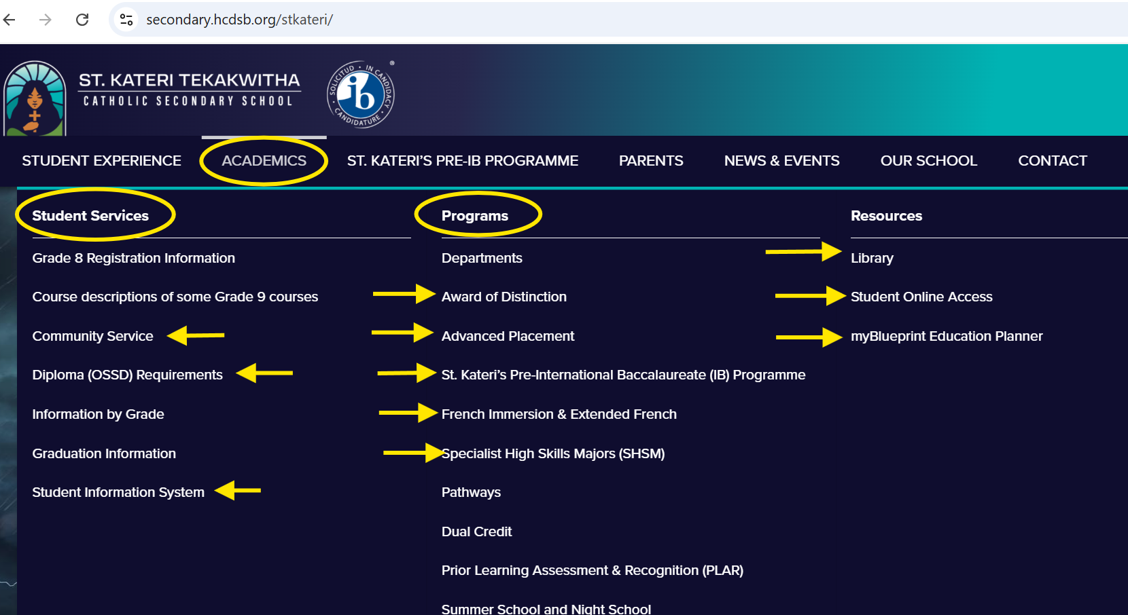

Slide 24
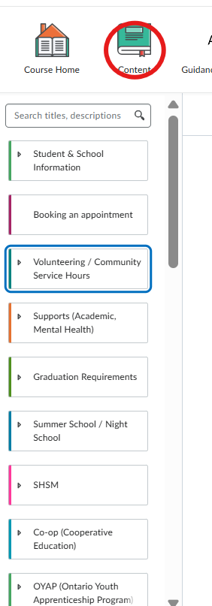
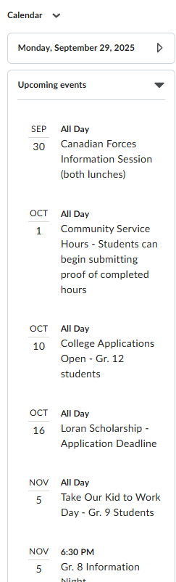
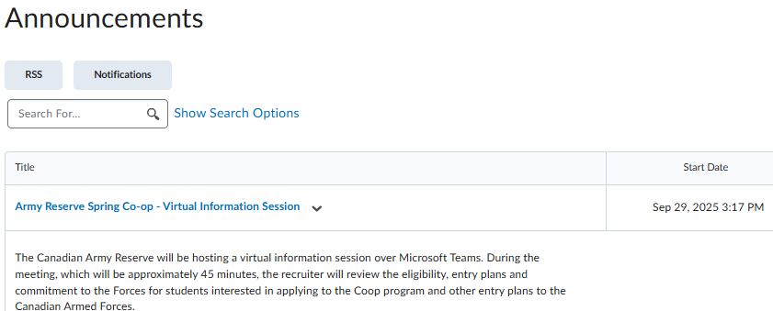
Student Services D2L Site
Check our site frequently for information about:
Volunteer opportunities
Enrichment opportunities
Course selection
Post-secondary pathway planning
And more!
Notes:
Jacob

Slide 25
Student Services D2L Site- Content
School info Booking an appointment Community Service Hours Supports (academic & mental health) Graduation requirements Summer school & Night school SHSM Co-op OYAP French programs Pre-IB program AP program | My Blueprint and Career Exploration Course selection Enrichment opportunities Grade-specific info Apprenticeship & Skilled trades College Transfer Credits University Vocations US and International Schools Portfolios and Supplementary Applications Preparing & Transitioning to Post Secondary Scholarships

Slide 26

School Involvement:
Extracurricular Clubs and Teams
Variety of opportunities based on student interests
Have an idea for a club? Share with a teacher or Mr. Wong
Why are extracurricular activities so important?
Develops various skills: leadership, teamwork, time management, networking
Develops confidence
Increases academic performance
Enhances post-secondary applications
Notes:
Getting involved in the extracurricular life at the school is an excellent way for you to forge relationships and make connections here at the school

Slide 27
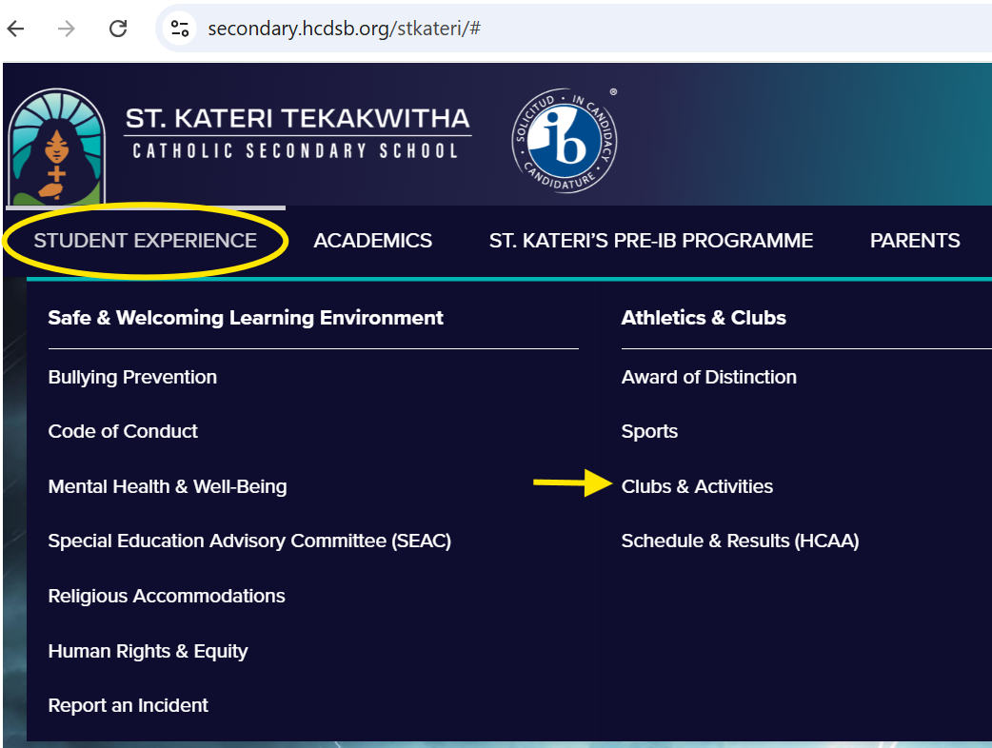
Where to find info about Clubs & Activities
Daily Announcements: listen carefully and review the slides each day!
School website
Notes:
Liza

Slide 28
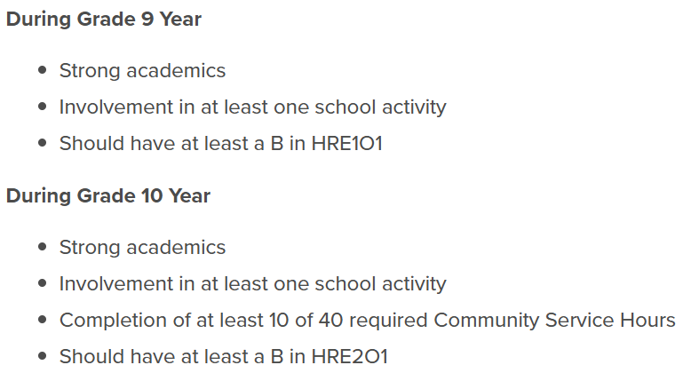
Awards of Distinction

Slide 29

Notes:
This is an EXCITING opportunity to share. On October 22nd - St. Kateri will be bringing a bus of 40 students to Dreamer Day at Enercare in Toronto – this day is a celebration of dreams and aspirations. You can expect lively panel discussions, interactive photo stations, 50+ exhibitors, and engaging workshops bring ambition to life. The goal of this day is to empower female identifying students who are interested in skilled trades, STEAM, emergency response, entrepreneurship, and leadership. If you are interested in being considered for this trip, a link to Google Form will be posted after this presentation on D2L. We will follow up with confirmation email of who has been selected later next week. Deadline to apply is THURSDAY, OCTOBER 9th. Any questions - please drop by Student Services

Slide 30

We look forward to working with you this year!
Mrs. Howitt – Guidance Secretary
Mrs. Pietrobon-Flynn – Guidance Counsellor, surnames A - E
Mr. Resendes – Guidance Counsellor, surnames F - N
Ms. Sneyd – Guidance Counsellor, surnames O - Z
Mrs. Bell - Alternative Education & Student Success Teacher
Mrs. Klimitz - Alternative Education & Student Success Teacher
Notes:
Jacob

